Slide 1
Logical Agents
Fundamentals of Artificial Intelligence
Slides are mostly adapted from AIMA and MIT Open Courseware

Slide 2
Outline
Knowledge-based agents
Wumpus world
Logic in general - models and entailment
Propositional (Boolean) logic
Equivalence, validity, satisfiability
Inference rules and theorem proving
  forward chaining
  backward chaining
  resolution

Slide 3
Introduction
The representation of knowledge and the reasoning processes that bring knowledge to life are central to entire field of artificial intelligence
Knowledge and reasoning are important to artificial agents because they enable successful behaviors that would be very hard to achieve otherwise (no piece in chess can be on two different squares at the same time)
Knowledge and reasoning also play a crucial role in dealing with partially observable environments (inferring hidden states in diagnosing diseases, natural language understanding)
Knowledge also allows flexibility.
Notes:
In the previous lectures, we showed that an agent that has goals and searches for solutions to the goals can do better than
One that just reacts to its environment
Now, we will extend the capabilities of agents by including the capacity for general logical reasoning
A logical, knowledge based agent begins with some knowledge of the world and its own actions.
It uses logical reasoning to maintain a description of the world, as new percepts arive
And to deduce a course of action that will achieve its goals.
Knowledge based approach is a powerful way of constructing an agent program.
It aims to implement a view of agents in which they can be seen as knowing about their world.,
And reasoning about their possible courses of action.
Knowledge based agents are able to accept new tasks in the form of explicitly described goals
They can achieve competence quickly by being told or learning new knowledge about the environment
And they can adopt to changes in the environment by updating the relevant knowledge

Slide 4

Knowledge bases
Knowledge base = set of sentences in a formal language
Each sentence is expressed in a knowledge representation language and represents some assertions about the world
There should be a way to add new sentences to KB, and to query what is known
Declarative approach to building an agent (or other system):
  TELL it what it needs to know
  Then it can ASK itself what to do - answers should follow from the KB
Both tasks may involve inference – deriving new sentences from old
In logical agents – when one ASKs a question to KB, the answer should follow from what has been TELLed
Agents can be viewed at the knowledge level
  i.e., what they know, regardless of how implemented
Or at the implementation level
  i.e., data structures in KB and algorithms that manipulate them
Notes:
A central component of a knowledge based agent is its knowledge base, KB
KB is a set of representations of facts about the world.
Each individual representation is called a sentence.
The sentences are expressed in a language, called a knowledge representation language
Adding new sentences to the knowledge base is called as TELL
And querying what is known is called as ASK
When one ASKs a question to the knowledge base, the answer should follow from what has been told (TELLed)
Determining what follows from what the KB has been told is the job of the INFERENCE mechanism

Slide 5

A simple knowledge-based agent
KB : maintain the background knowledge
Each time the agent program is called it does three things
  TELLs the KB what it perceives
  ASK the KB what action it should perform
  TELL the KB that the action is executed
The agent must be able to:
  Represent states, actions, etc.
  Incorporate new percepts
  Update internal representations of the world
  Deduce hidden properties of the world
  Deduce appropriate actions
Declarative versus procedural approaches
Notes:
A knowledge based agent takes a percept as input and returns an actions as the other agents do
The agent maintains a knowledge base which may initially contain some background knowledge
Each time the agent program is called it does two things
First it TELLs the knowledge base what it perceives
Second it ASKs the knowledgebase what action it should perform.
In the process of answering this query,
Logical reasoning is used to prove which action is better than all others
Given what the agent knows and what its goals are
The agent then performs the chosen action.
MAKE-PERCEPT-SENTENCE takes a percept and a time and returns a sentence representing the fact that the agent perceived the percept at a given time.
MAKE-ACTION-QUERY takes a time as input and returns a sentence that is suitable for asking what action should be performed at that time.

Slide 6

Wumpus World PEAS description
Performance measure
  gold +1000, death -1000
  -1 per step, -10 for using the arrow
Environment
  Squares adjacent to wumpus are smelly (stench)
  Squares adjacent to pit are breezy
  Glitter iff gold is in the same square
  Shooting kills wumpus if you are facing it
  Shooting uses up the only arrow
  Grabbing picks up gold if in same square
  Releasing drops the gold in same square
Sensors: Stench, Breeze, Glitter, Bump, Scream
Actuators: Left turn, Right turn, Forward, Grab, Release, Shoot
Notes:
We will first work on a simple example: Wumpus world
Wumpus was an early computer game based on an aganet who explores a cave consisting of rooms connected by passageways
Wumpus is a beast that eats anyone who enters it is room, which can be anywhere in the cave.
Some rooms contain bottomless pits that will trap anyone who enters into that room (except for the wumpus who is too big to fall in)
The only nice thing about this environment is the gold hidden in some room.
In the square containing the wumpus and in the directly adjacent squares the agent will perceive a stench
In the squares directly adjacent to a pit, the agent will perceive a breeze
In the square where the gold is, the agent will perceive a glitter
When an agent walks into a wall it will perceive a bump
When wumpus is killed it gives out a woeful scream that can be perceived anywhere in the cave
The percepts will be given to an agent in the form of a list of five symbols
[Stench, Breeze, Glitter, Bump, Scream]
The agent cannot perceive its own location
The actions are go forward, turn right and turn left
Also Grab is used to pickup an object that is in the same square as the agent.
We will use it to pick up the gold
Shoot can be used to fire an arrow in a straight line in the direction that the agent is facing
The arrow either hits the wumpus or the wall
There is only one arrow
The agent dies if it enters a square containing a pit or a live wumpus
The agent’s goal is to find the gold without getting killed.

Slide 7
Wumpus world characterization
Fully Observable No – only local perception
Deterministic Yes – outcomes exactly specified
Episodic No – sequential at the level of actions
Static Yes – Wumpus and Pits do not move
Discrete Yes
Single-agent? Yes – Wumpus is essentially a natural feature
Notes:
The agent starts in the square labeled (1,1)
The location of the gold and wumpus are chosen randomly
It is a partially observable, deterministic, sequential, and static environment

Slide 8

Exploring a wumpus world
[1,1] is OK
Because
Haven’t fallen into a pit
Haven’t been eaten by a Wumpus
[1,2] and [2,1] are OK
Because
No stench
No breeze
Notes:
Now, we will work on an example
We start from 1,1
Since there is no stench or breeze in [1,1] the agent can infer that [1,2] and [2.1] are safe
So we mark them with OK

Slide 9

Exploring a wumpus world
We move to [1,2] and
Feel a Breeze
Notes:
Let’s now suppose that agent moves to [1.2]
The agent detects breeze (B) in [1,2] so there must be a pit in the neighboring squares

Slide 10

Exploring a wumpus world
Notes:
The pit can be either at [2.2] or [1,3]
The notation p? indicates a possible pit
The pit cannot be in [1,1] because agent was already there, and did not fall in

Slide 11

Exploring a wumpus world
Notes:
So the agent will turn around, and go back to [1,1]
And then proceed to [2.1]

Slide 12

Exploring a wumpus world
Notes:
The agent detects a stench in [2,1] which means that there must be a wumpus nearby
But the wumpus cannot be in [1,1] as we know already
It cannot be in [2,2] as well because agent did not detected a stench when it was at [1,2]
Therefore the agent can infer that the wumpus is in [3.1]
The notation W indicates this
Since there is no breeze detected in [2,1] this means that there is no pit in [2,2]
Therefore the pit must be at [1,3]

Slide 13

Exploring a wumpus world
Notes:
Since the only option left as safe (OK) is [2,2] the agent moves there

Slide 14

Exploring a wumpus world
Notes:
There is no breeze or stench
So both [2,3] and [3,2] are safe

Slide 15

Exploring a wumpus world
Notes:
Let’s move to [3,2]
The agent detects a glitter
Now the agent is lucky because the gold is there
The agent will grab it and go back

Slide 16
Logic in general
Logics are formal languages for representing information such that conclusions can be drawn
Syntax defines the sentences in the language
Semantics define the "meaning" of sentences;
  i.e., define truth of a sentence in a world
E.g., the language of arithmetic
  x+2 ≥ y is a sentence; x2+y > {} is not a sentence
  x+2 ≥ y is true iff the number x+2 is no less than the number y
  x+2 ≥ y is true in a world where x = 7, y = 1
  x+2 ≥ y is false in a world where x = 0, y = 6
Notes:
Now, we will talk about of logic in general, as a formal language representing the knowledge
The syntax of a language describes the possible configurations that can constitute sentences
The semantics determines the facts in the world to which the sentences refer.
With semantics each sentence makes a claim about the world
For example
The syntax of the language of arithmetic expression says that if x and y are expressions denoting numbers
Then x+2>=y is a sentence about numbers
The semantics of the language says that x+2>=y is false when y is at least 2 bigger than x, and true otherwise

Slide 17
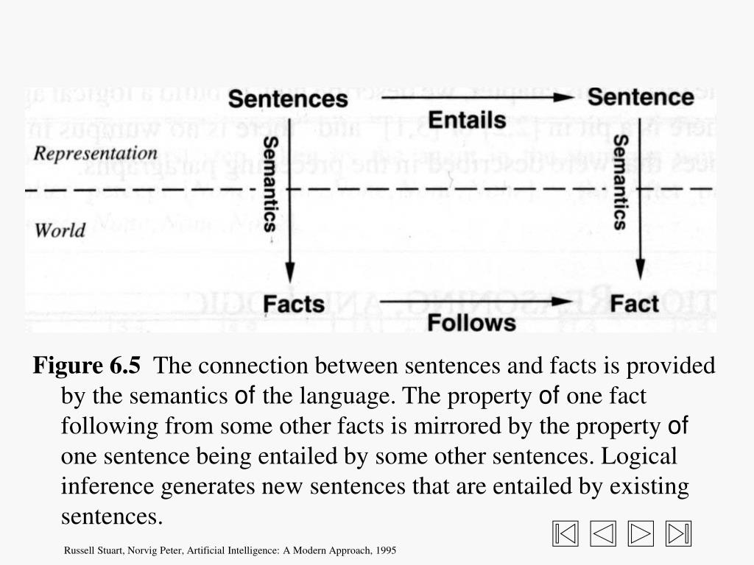

Entail : involve (something) as a necessary or inevitable part or consequence.
Notes:
Recall that, Determining what follows from what the KB has been told is the job of the INFERENCE mechanism
From the syntax and semantics we can derive an inference mechanism for an agent that uses the representation language which we call as logic
Recall that semantics of the language determine the fact to which a given sentence refers
It is important to distinguish between facts and their representations
Facts are part of the world.
Whereas their representations must be encoded in some way that can be physically stored within an agent.
We cannot put the world inside an agent/human
So all reasoning mechanisms must operate on representations of facts, rather than on the facts themselves
The connection between sentences and facts is provided by the semantics of the language.
The property of one fact following from some other facts is mirrored by the property of one sentence being entailed by some other sentences
Logical inference generates new sentences that are entailed by existing sentences

Slide 18
Entailment
Entailment means that one thing follows from another:
KB ╞ α
Knowledge base KB entails sentence α if and only if α is true in all worlds where KB is true
  If α true then KB must also be true
  E.g., the KB containing “the Giants won” and “the Reds won” entails “Either the Giants won or the Reds won”
  E.g., x+y = 4 entails 4 = x+y
  Entailment is a relationship between sentences (i.e., syntax) that is based on semantics
Notes:
We want to generate new sentences that are necessarily true given that the old sentences are true
This relation between sentences is called entailment, and mirrors the relation of one fact following from another
In mathematical notation, the relation of entailment between a knowledge base KB and a sentence alpha is pronounced
“KB entails alpha” and written as KB |= alpha
Knowledge base KB entails sentence α if and only if α is true in all worlds where KB is true
That is if α true then KB must also be true
For example:
the KB containing “the Giants won” and “the Reds won” entails “Either the Giants won or the Reds won”
Or
x+y = 4 entails 4 = x+y

Slide 19

Models
Logicians typically think in terms of models, which are formally structured worlds with respect to which truth can be evaluated
We say m is a model of a sentence α if α is true in m
M(α) is the set of all models of α
Then KB ╞ α iff M(KB) ⊆ M(α)
  E.g. KB = Giants won and Reds won
  α = Giants won
Possible world – model
m is a model of α – the sentence α is true in model m
Notes:
In order to understand entailment in more detail, now let’s discuss the relation between models and entailment
Model is a formally structured world with respect to which truth can be evaluated
We say that m is a model of a sentence alpha if alpha is true in m
Let’s represent the set of all models of alpha as M(alpha)
We say that KB entails a sentence alpha
If set of models of KB is a subset of set of models of alpha
For example
Gians won and red wons entails Giants won
Because the models that makes the KB true also makes the alpha true

Slide 20

Entailment in the wumpus world
Situation after detecting nothing in [1,1], moving right, breeze in [2,1]
Notes:
Let’s consider the wumpus world example
(Note that in this figure the world is rotated)
Remember the situation after detecting nothing in [1,1] and moving to [2,1] where we detect breeze

Slide 21

Wumpus models
3 Boolean choices ⇒ 8 possible models
for the adjacent squares [1,2], [2,2] and [3,1] to contain pits
Notes:
There are three neighbors of the observed calls [1,1] and [2,1] which are
[1,2], [2,2], and [3,1]
Consider possible models only based on pits
There are 2^3 = 8 models representing the possibility of pit in those 3 cells.
All the cells may include a pit
Or none of them may have a pit
There can be one or two pits etc.

Slide 22

Wumpus models
Consider possible models for KB assuming only pits
KB = wumpus-world rules + observations
KB is false in any model in which [1,2] contains a pit, because there is no breeze in [1,1]
Notes:
Now, we will see how we can get new facts about the facts that we obtained by observing [1.1] and [2,1]
Our KB corresponds to wumpus world rules and our previous observations.
Since there is a breeze in [2,1] we should have pit at least in one of [2,2] or [3,1]
On the other hand
KB = “There is a pit in [.,.] “ is false in any model in which [1,2] contains a pit, because there is no breeze in [1.1]
So only in the models shown in red, KB is true

Slide 23

Wumpus models
Consider α₁ = “[1,2] is safe” = “There is no pit in [1,2]”
In every model KB is true α₁ is also true
KB ╞ α₁, proved by model checking
We can conclude that there is no pit in [1,2]
Notes:
Now consider the sentence “[1,2] is safe” that is : “there is no pit in [1,2]”
The models that make the sentence true are shown in yellow
In every model KB is true alpha1 is also true
So KB entails alpha1 and
We can conclude that there is no pit in [1,2]

Slide 24

Wumpus models
Consider α₂ = “[2,2] is safe” = “There is no pit in [2,2]”
In some models in which KB is true α₂ is false
KB ╞/ α₂
We cannot conclude that there is no pit in [2,2]
Notes:
Now consider another sentence alpha2 = there is no pit in [2,2]
In some models where KB is true alpha2 is false
So KB does not entail alpha2
And we cannot conclude that there is no pit in [2,2]

Slide 25
Inference
KB ├_{i} α = sentence α can be derived from KB by a procedure i (an inference algorithm)
Soundness: i is sound if whenever KB ├_{i} α, it is also true that KB╞ α
An inference algorithm that derives only entailed sentences is sound or truth preserving (model checking is a sound procedure)
  If the system proves that something is true, then it is really true. The system doesn’t derive contradictions
Completeness: i is complete if whenever KB╞ α, it is also true that KB ├_{i} α
An inference algorithm is complete if it can derive any sentence that is entailed
  If something is really true, it can be proven using the system. The system can be used to derive all the true statements one by one
If KB is true in the real world then any sentence α derived from KB by a sound inference procedure is also true in real world
  The conclusions of the reasoning process are guaranteed to be true in any world in which the premises are true
Notes:
An inference procedure can do one of two things:
Given a knowledge base KB, it can generate new sentences alpha that are entailed by KB
Or, given a KB and another sentence alpha, it can report whether or not alpha is entailed by KB
An inference procedure that generates only entailed sentences are called SOUND or TRUTH-PRESERVING
An inference procedure I can be described by the sentences that it can derive.
If I can derive alpha from KB, it is written as KB |-i alpha
Which is pronounced as “alpha is derived from KB by i” or
“I derives alpha from KB”
Sometimes the inference procedure is implicit and I is omitted
The operation of a sound inference procedure is called a proof.
An inference procedure is complete it can find a proof for any sentence that is entailed
The key to sound inference is to have the inference steps respect the semantics of the sentences they operate upon.
That is given a knowledge base KB, the inference steps should only derive new sentences that represent facts that follow from the facts represented by KB

Slide 26
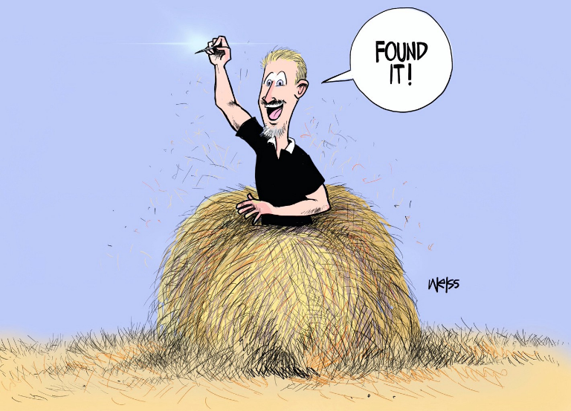
Inference
All consequences of a KB is a haystack
α is a needle
Entailment
The needle being in the haystack
Inference
Finding the needle
An unsound inference procedure essentially makes things up as it goes along – it announces the discovery of non-existent needles
For completeness, a systematic examination can always decide whether the needle is in the haystack which is finite
Cartoon illustrations by John P. Weiss
Notes:
Now, think of the set of all consequences of KB as a haystack and alpha as a needle.
Entailment is like the needle being in the haystack
Proof is like finding it
An inference procedure is complete if it can find a proof for any sentence that is entailed.
An unsound inference procedure essentially makes things up as it goes along – it announces the discovery of nonexistent needles
For real stacks, which are finite in extent it seems obvious that a systematic examination can always decide whether the needle is in the haystack
But for many knowledge bases the haystack of consequences is infinite, and completeness becomes an important issue.

Slide 27
Semantics and Inference
Interpretation: establishing a correspondence between sentences and facts
Compositional: the meaning of a sentence is a function of the meaning of its parts
A sentence is TRUE under a particular interpretation if the state of the affairs it represents is the case
S_{1,2} would be true
  under the interpretation
  “there is a stench in [1,2]”
  on this Wumpus world
Logical Inference: A process that implements the entailment relation between sentences
Notes:
Meaning of a sentence is what it states about the world. How does a sentence get its meaning?
Or how do we establish the correspondence between sentences and facts?
The writer of the sentence has to provide an interpretation to say what fact it corresponds to.
All representation languages impose a systematic relationship between sentences and facts
In compositional languages the meaning of a sentence is a function of the meaning of its parts
Once a sentence is given an interpretation by the semantics, the sentence says that the world is this way and not this way, which is TRUE or FALSE
A sentence is TRUE under a particular interpretation if the state of the affairs it represents is the case
Truth depends both on the interpretation of the sentence and on the actual state of the world.
For example the sentence “S12” would be true under the interpretation in which it means that there is a stench in [1,2]
In the wumpus world shown here.
But it would be false in worlds that do not have a stench in [1,2]
If the interpretation is “there is a breeze in [1,2] it would be false in this world.
The terms reasoning and inference are generally used to cover any process by which conclusions are reached.
Logical inference or deduction is a process that implements the entailment relation between sentences
, and it is a sound reasoning mechanism

Slide 28
Validity and satisfiability
A sentence is valid if it is true in all models,
e.g. “There is a stench at [1,1] or there is not a stench at [1,1]”
Valid sentences are also called as tautologies
Every valid sentence is equivalent to True
A sentence is satisfiable if it is true in some model
e.g. “There is a Wumpus at [1,2]”
If a sentence is true in a model m, then we say m satisfies the sentence, or a model of the sentence
A sentence is unsatisfiable if it is true in no models
  e.g. “There is a wall in front of me and there is no wall in front of me”
Notes:
A sentence is valid or necessarily true if and only if it is true under all possible interpretations ın all possible worlds.
For example “There is a stench at [1,1] or there is not a stench at [1,1]” is valid
Because it is true whether or not there is a stench in [1,1]
And it is true regardless of the interpretation
A sentence is satisfiable if and only if there is some interpretation oin some world for which it is true.
The sentence “There is a Wumpus at [1,2]” is satisfiable because there might be a wumpus in that square in some worlds.
A sentence that is not satisfiable is unsatisfaible.
Self contradictory sentences are unsatisfiable.
Its contradictoriness does not depend on the meaning of the symbol.
For example. The sentence “There is a wall in front of me and there is no wall in front of me” is unsatisfiable.

Slide 29
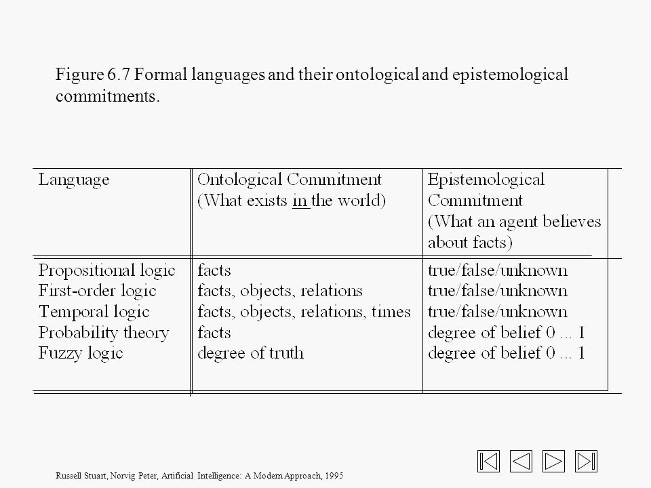
Logics - Summary
Logic consists of
A formal system consisting of
  syntax
  semantics
The proof theory
Notes:
To summarize:
A logic consists of
A formal system for describing states of affairs, consisting of
a. the syntax of the language, which describes how to make sentences
b. The semantics of the language, which states the systematic constraints on how sentences relate to states of affairs
The proof theory – a set of rules for deducing the entailments of a set of sentences
We will concentrate on two kinds of logic:
Propositional or Boolean logic
And first order logic
In propositional logic symbols represent whole propositions (facts)
For example D might have the interpretation “the wumpus is dead”
which may or may not be a true proposition.
Proposition of symbols can be combined using Boolean connectives to generate sentences with more complex meaning
First order logic commits to the representation of worlds in terms of objects and predicates on objects.
(such as properties of objects or relations between objects)
As well as connective and quantifiers which allow sentences to be written about everything in the universe at once.
There are other logic types: we can consider them based on their ontological and epistemological commitments
Ontological commitments are about the nature of reality
For example, propositional logic assumes that there are facts that either hold or not in the world, i.e. the facts are either true or false
First order logic assumes more: The world consists of objects with certain relations between them that do or do not hold.
Special purpose logics make further ontological commitments.
For example temporal logic assumes that the world is ordered by a set of time points or intervals.
Epistemological commitments are about the possible states of knowledge an agent can hacve using various types of logic.
In both propositional and first order logic a sentence represents a fact and an agent either believes the sentence is true or false, or unable to conclude either way.
Systems using probability theory, on the other hand, can have any degree of belief ranging from 0 to 1
For example , a probabilistic wumpus world agent might believe that the wumpus is in [1,3] with probability 0.75
Systems based on fuzzy logic can have degrees of belief in a sentence, and also allow degrees of truth
For example Vienna is a large city might be true only to degree 0.6

